Slide 1




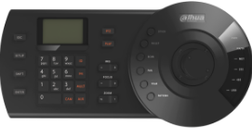


Topology
HDCVI
…...
HDMI 1
16 Unit
HCVR
NVS0104DH
HDCVI
HDMI 2
NVS0104DH
…...
…...
HDMI 3
Switch
NVS0104DH
HDCVI
HDMI 4
16 Unit
…...
NVS0104DH
HCVR
HDCVI
160xHD-CVI input
10xHCVR
Decoder + 4xHDMI outputs + Keyboard

